Slide 1
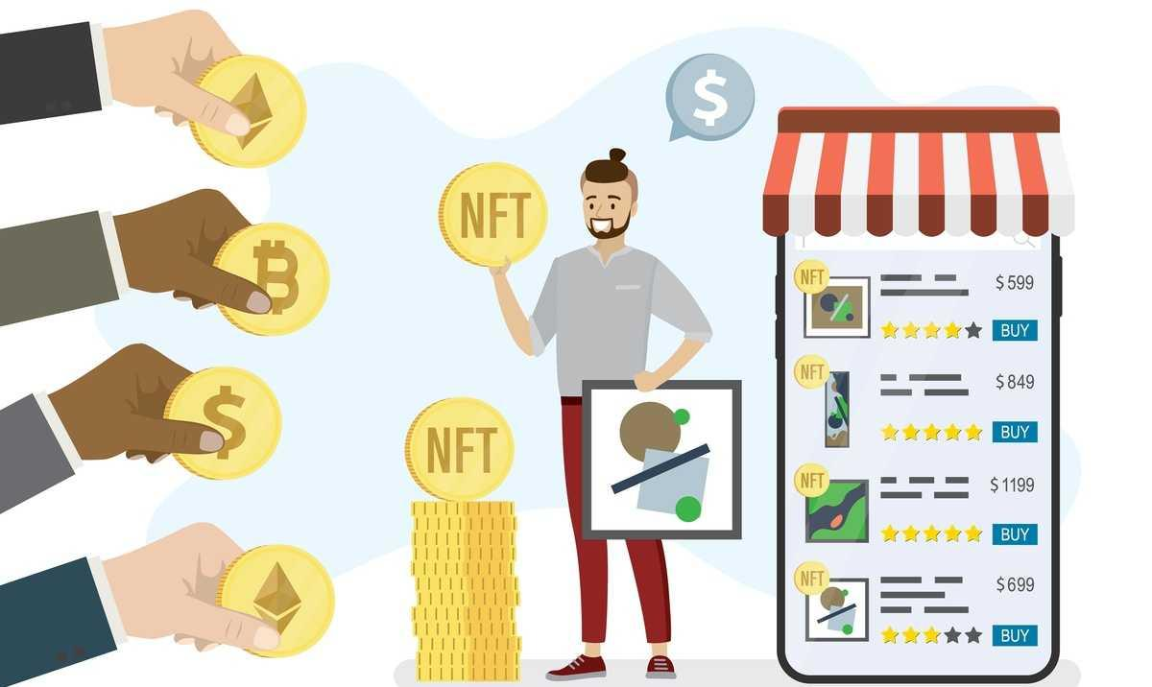
NFT Ticket Marketplace
John, Adnan, Mike, Brandon
Notes:
JOhn

Slide 2
Introduction
Motivation
Create a decentralized ticketing & digital merchandise platform to empower artists and creators to engage directly with fans through events and exclusive content.
Value Proposition:
Lower fees than traditional ticketing platforms
Secure transactions verified on the blockchain
Royalty payments from merchandise + ticketing revenue for event organizer
Robust secondary market for tickets and merchandise driving royalty payments
Aggregate data from all events on our platform to provide an analytics platform for event organizers
Notes:
John

Slide 3
Challenges
Connecting the Smart Contract with the Streamlit App was the more challenging part of the project for us.
Initially, we wrote and successfully deployed very feature rich smart contracts, however we were running out of time to successfully embed those features in python app with streamlit interface.
Therefore for today’s demo we reverted to a simple prototype executing selection and purchase of concert ticket as an NFT, to demonstrate proof of concept.
Notes:
Brandon

Slide 4
Web App Evaluation
While we did get the outcome we desired, we found that there was much room to grow in several directions and provide many more services via the smart contract.
Due to time constraint we could not implement such features. An example of something else we wanted to add was a secondary NFT market associated with the event, performer or related products.
In the future the prototype can be developed with a more feature rich smart contract and complete marketplace or exchange to trade NFTs with a social site to create a forum, meeting place for users, to encourage growth of the product.
Notes:
Brandon

Slide 5
Competition Comparison
Ticketmaster, Stubhub
Charge 10% per ticket
Comparatively inefficient and costly
TiX acdvantages - Efficiency in both cost and operations
Fewer steps and personnel needed to sell a ticket
Reduction in transaction errors
Cost compared to traditional ticket sales (Ticketmaster)
Notes:
Mike

Slide 6
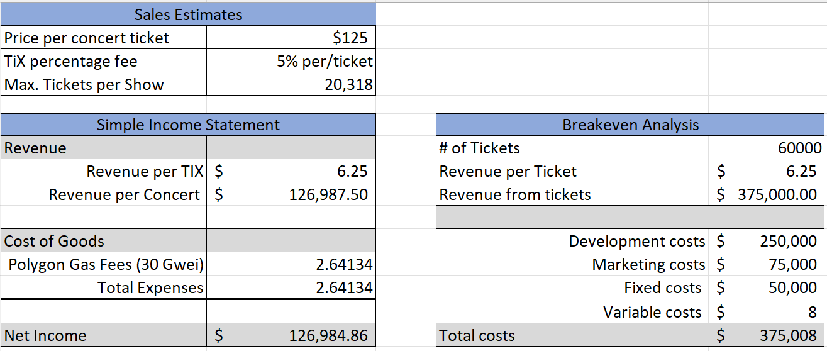
Financial Projections
Notes:
Mike

Slide 7
Demo
Notes:
Adnon

Slide 8
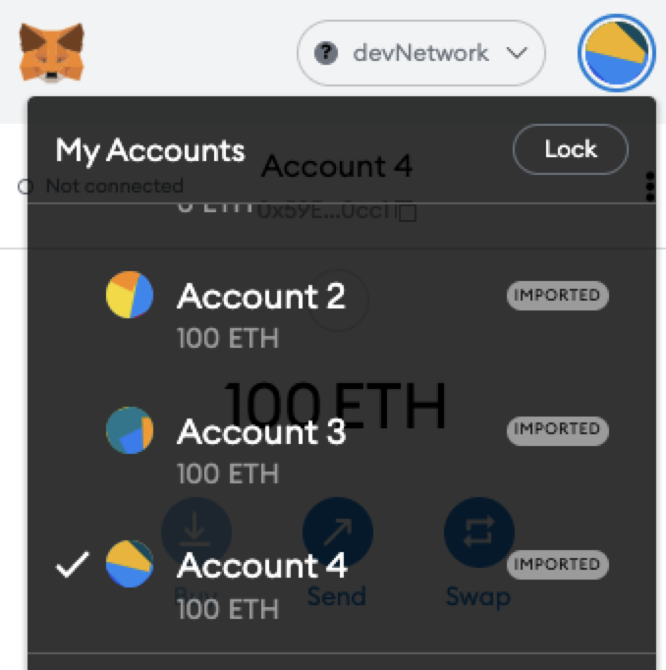
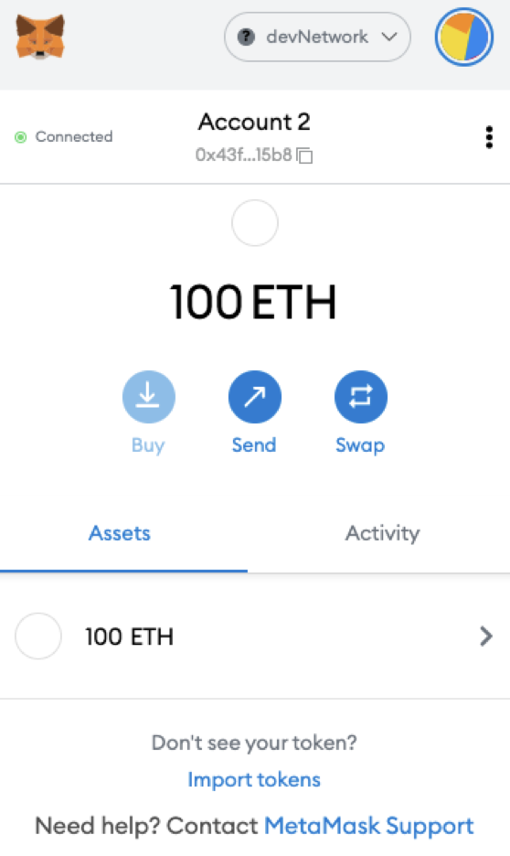
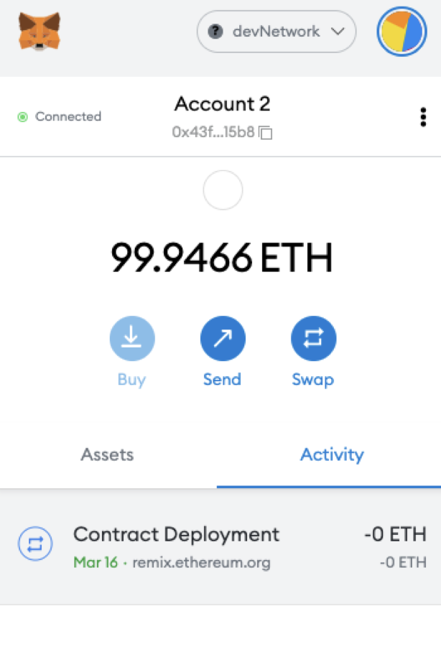
Prototyping an exchange place for NFT
Exchange with accounts of Sellers (2) and Buyers (3, 4)
The Seller or Event Organizer initiates by deploying the smart contract for NFT ticket sale.
Seller pays a one time Gas Fee if using Ethereum smart contract (equiv. To ~ $250 one time fee, no recurrent fee to Ticketmaster)
Notes:
Adnan

Slide 9
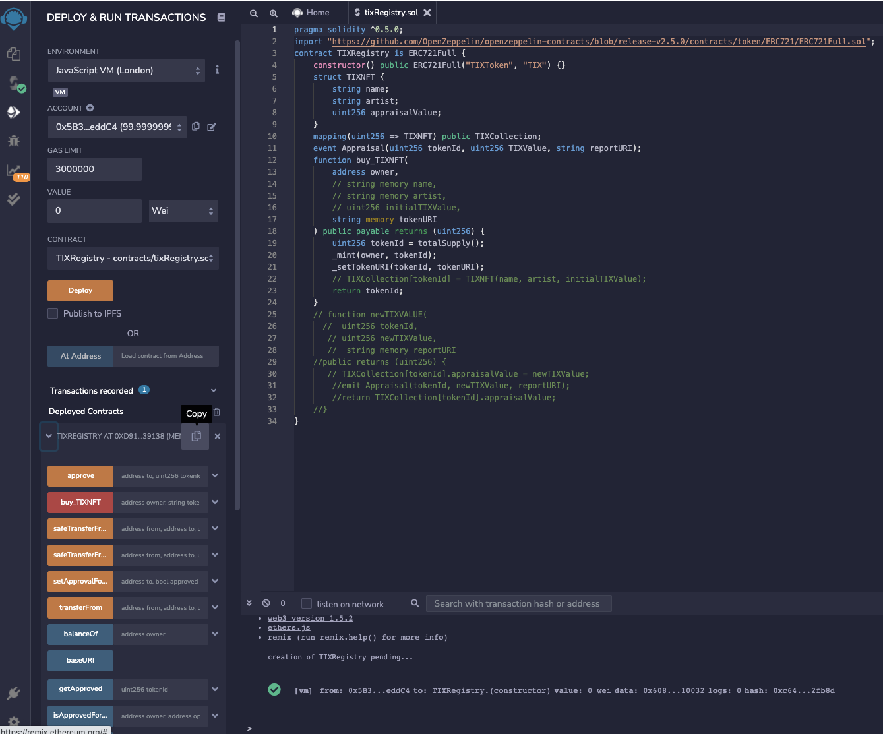
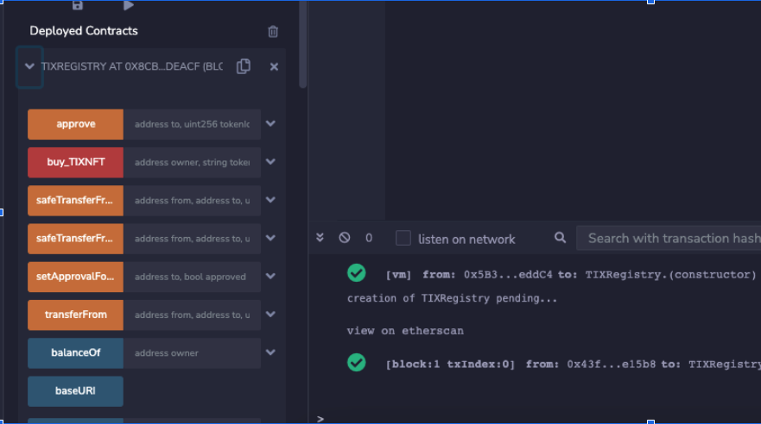
Simulating Contract Deployment Using Remix
Smart Contract deployed with a few simple lines of code to minimize both gas fee.
We used a simple prototype for demonstration purposes.
We have written and observed in github example of more complex contracts with rich features such as: i. Who is permitted to mint token ii. Max number of tokens and tickets by venue iii. Restrictions on reselling iv. Or pay a commission to organizer for a portion of profits from resale v. inclusion of memorabilia such as video from the event, etc.
Notes:
Adnan

Slide 10
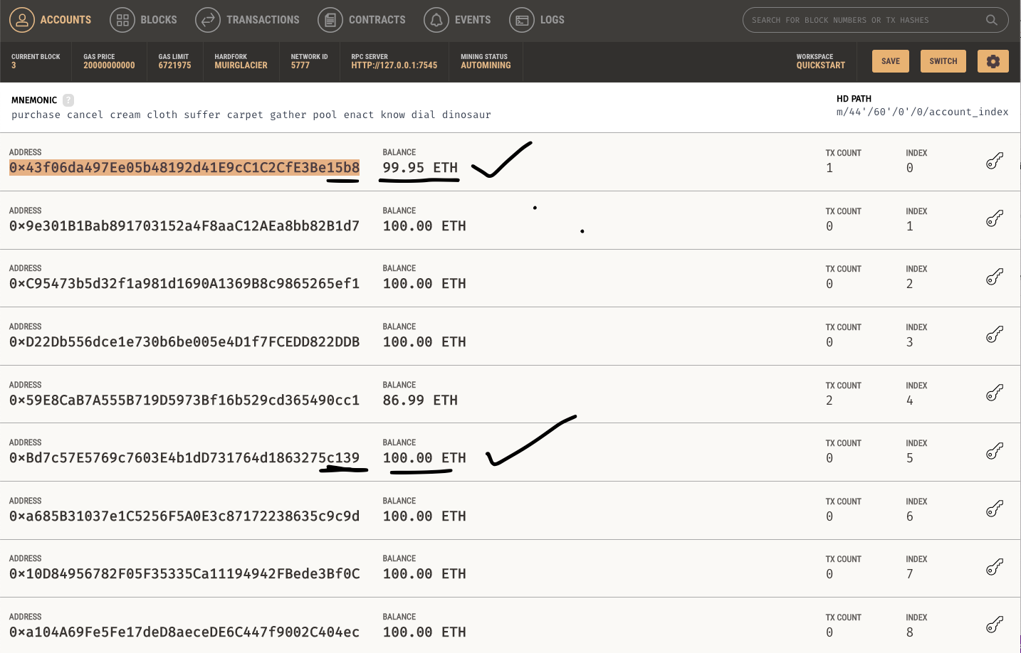
List of Accounts
Cost to the Organizer of deploying the Smart Contract.
As we learned from Alexi, we should write our contracts efficiently with only the features that are needed or useful, as code execution costs gas money.
Notes:
Adnan

Slide 11
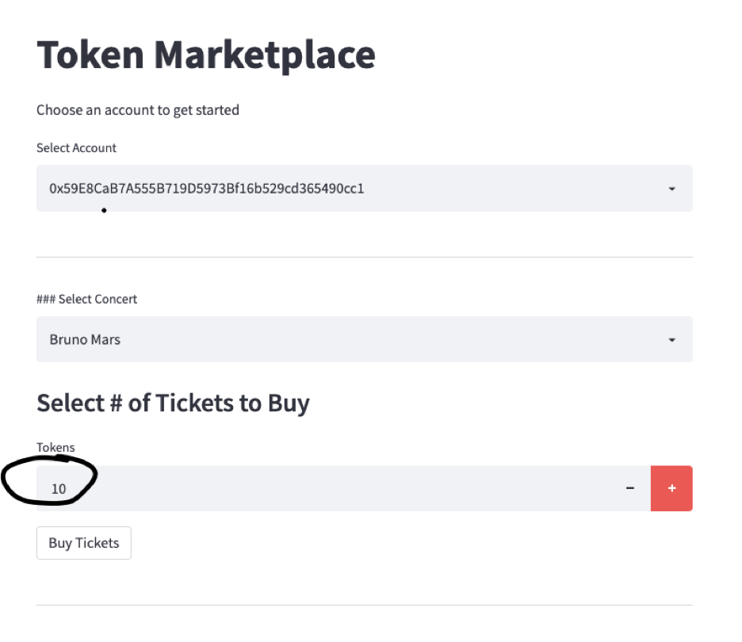
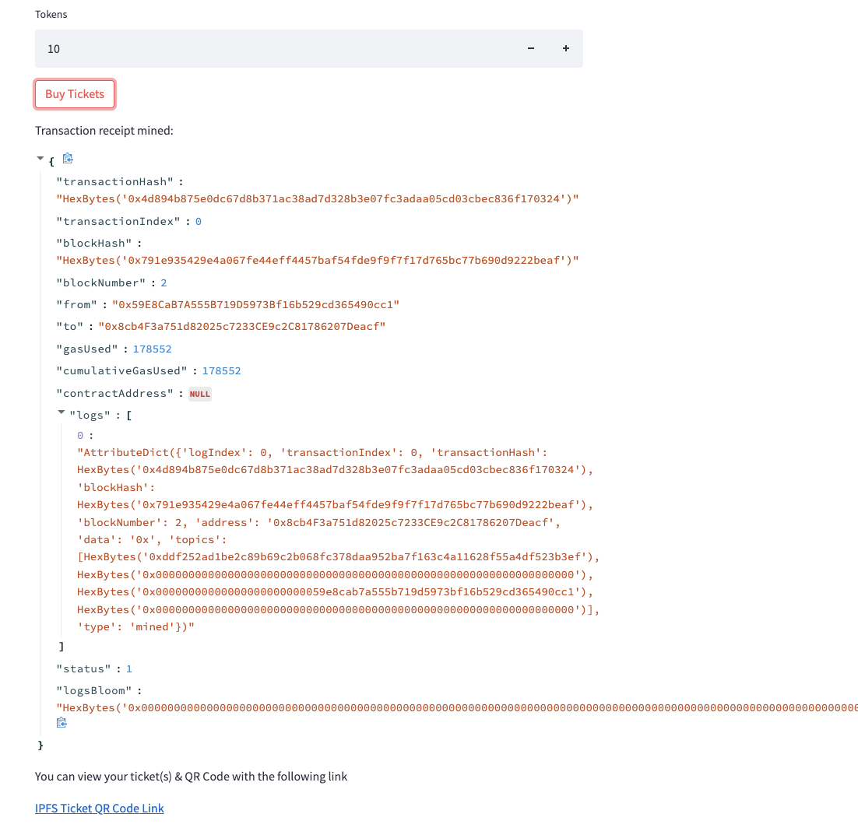
Purchasing an NFT
After 6 months of teaching us Python, ML, Blockchain, Solidity, Alexi, Spencer, Jacob, Kal and their friends are going to a virtual Bruno Mars concert in Meta. Screenshots of transaction selection, execution.
IPFS link stores QR Code of the NFT used for entry.
Notes:
Adnan

Slide 12
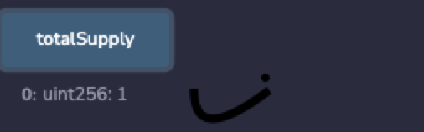
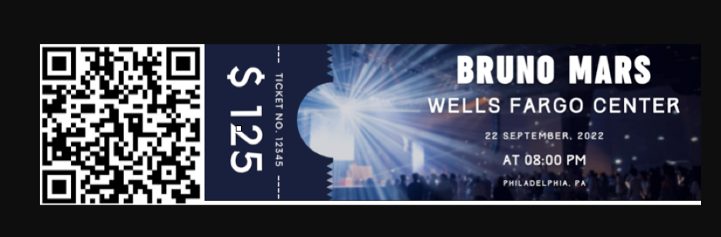
Minting a prototype NFT Ticket with QR Code
In this prototype to save gas on a For loop, we mint one NFT per transaction. The one QR Code below represents all 10 seats.
Smart Contracts can be flexible and programmed to the liking of the organizer
Notes:
Adnan

Slide 13
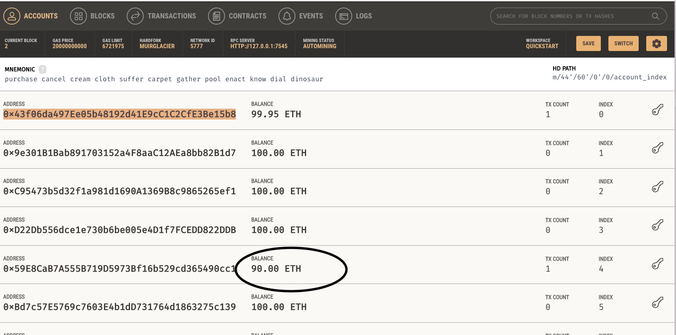
Pay into the Smart Contract
Account Index # 5 is the Buyer and paid 10 Eth for 10 tkts, that’s almost $3k per tkt, certainly VIP.
In this transaction the Ether was sent to the Smart Contract which then virtually disburses the funds as coded.
In the next example, we will show example of direct payment.
Notes:
Adnan

Slide 14
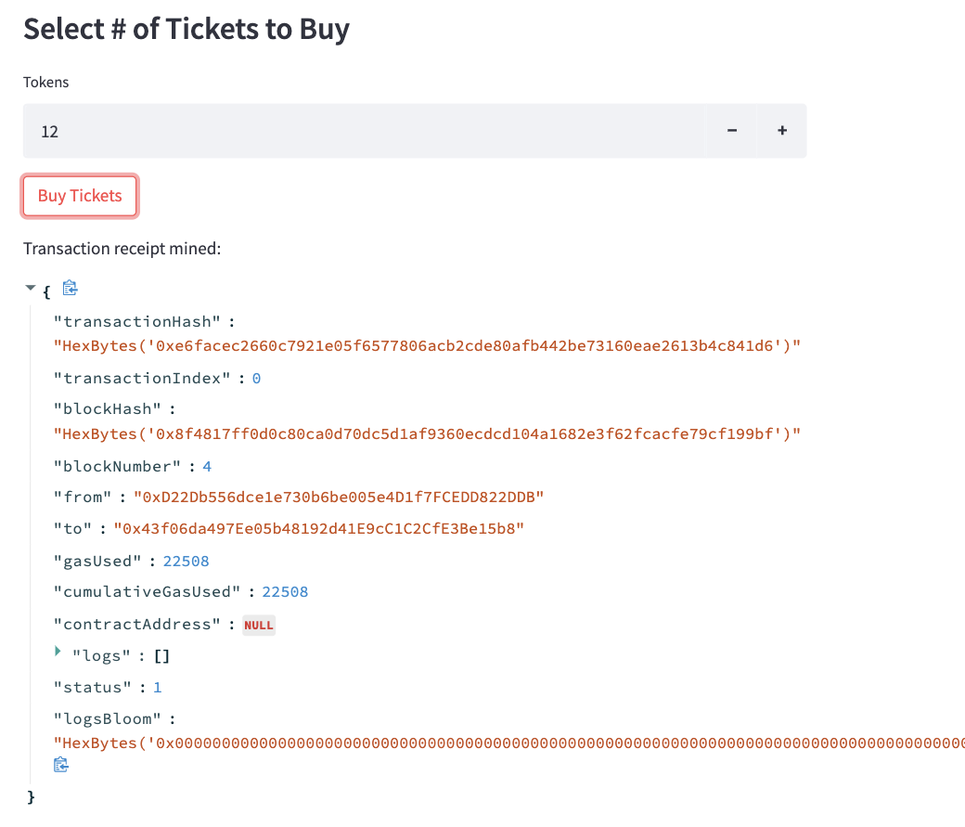
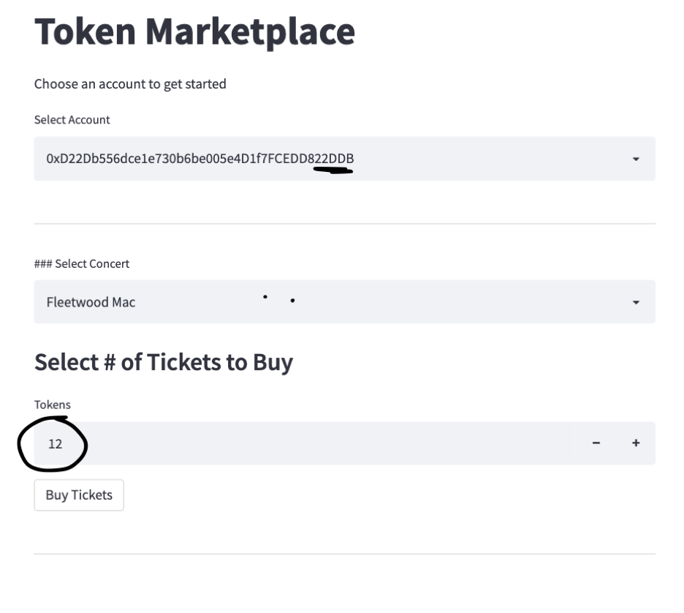
Next Concert - a different way to make payment
NFTs are for everyone. Here we have a group of Gen Xers buying tickets to a Fleetwood Mac Concert.
Notes:
Adnan

Slide 15
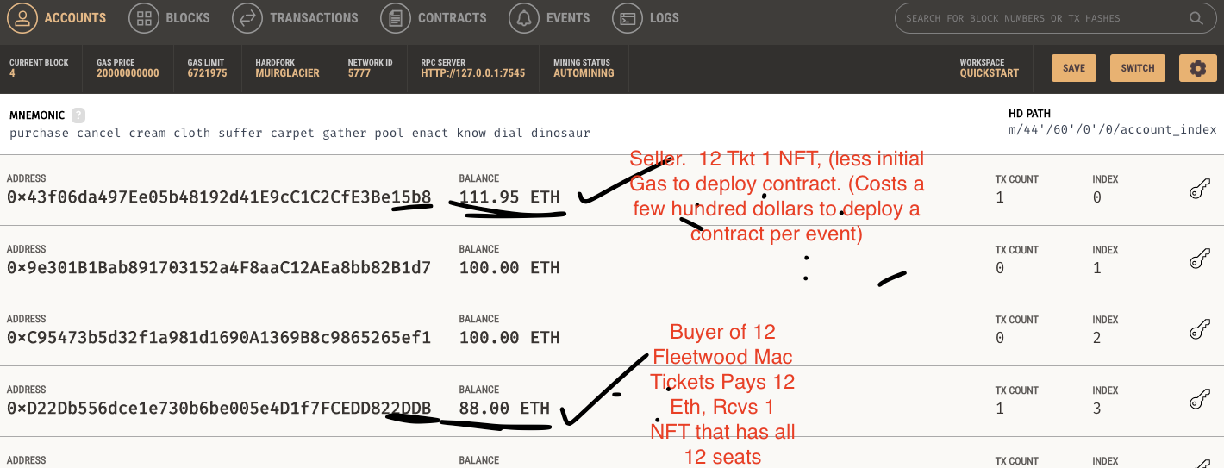
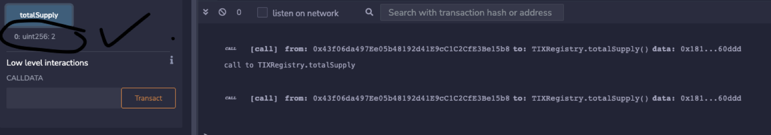
Alternate Payment - Direct
These group paid for the 12 tickets directly into the Sellers account
Notes:
Adnan

Slide 16
Concluding Remarks
The smart contract performed well in the virtual setup as evidenced with Metamask and Granache.
Enhancements can include reducing gas fees, consideration to switch from Ethereum to Solano or alternative platform to reduce energy consumption, increase speed, lower cost further, etc.
Notes:
John

Slide 17
Future Roadmap
Create front end interface for secondary sales platform
Run analytics for event
Revenue projections
Initial ticket mint supply
Secondary ticket sales
Incentive sales
Benchmarking statistics
Create smart contract for users to trade NFT merchandise from these events
Royalties to event organizer (artist)
Royalties to platform
Incentivize users to engage platform
Concerts - airdrop clip / song recordings to event attendees
Sports - airdrop clip of biggest in game moment
Photography from event
Loyalty rewards for holders of native token - Tokenomics
Exclusive events
Loyalty rewards for largest collectors of individual artists / teams
Exclusive NFTs
Notes:
John

